Slide 1
Software Architecture
CSE-864 Software System Design & Architecture

Slide 2
Software Architecture
As the size and complexity of software systems increases, the design and specification of overall system structure become more significant issue than the choice of algorithms and data structures.
Structural issues include system organization as a composition of components, protocols (rules) for communication, interaction through interfaces, etc.
This is the Software Architecture level of design.

Slide 3
What is Software Architecture?
A natural evolution of design abstractions.
Involves the description of elements from which system is built, interactions among those elements, patterns that guide their composition, and constraints on the patterns.
Considers system as a collection of components and their interactions.

Slide 4
Components & their Interactions
Components are such things as clients and servers, databases, layers, etc.
Interactions among components can be procedure calls, shared variable access, etc.
At the architectural level, we also consider system-level issues such as capacity, consistency, performance, etc.

Slide 5
Software Architecture
the fundamental organization of a system embodied(consist of) in its components, their relationships to each other, and to the environment, and the principles guiding its design and evolution [IEEE standard 1471–2000 ].
Software Architecture defines the observable properties of a software system
Software architecture of a program or computing system is the structure or structures of the system, which comprise(include) software elements, the externally visible properties of those elements and the relationships among them (Bass,
Software architecting means the process of creating software architectures

Slide 6
Architecture vs. Design
“All architecture is design, not all design is architecture”.
Architectural design is outward looking
    Focus on stakeholders, not technology
Architecture doesn't describe the complete characteristics of components – Design does.

Slide 7
Architecture vs. Design
Furthermore, the actual placement of the software architecting process within the software lifecycle further distinguishes it from the classical design phase.
In essence, the software architecting process has expanded the traditional design phase to include a phase that immediately precedes the traditional high-level design phase and will at times overlap this phase depending on the architectural view.

Slide 8
architecture
design
implementation
CODE

Slide 9
Architectural influences
Influences
  System Stakeholders
  Developing organization
  Architects’ background and experience
  Technical environment

Slide 10
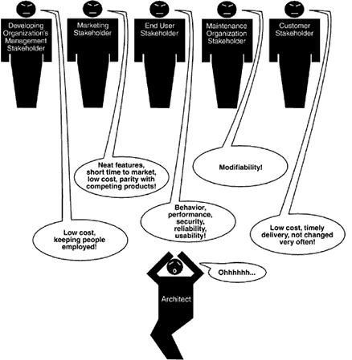

Slide 11
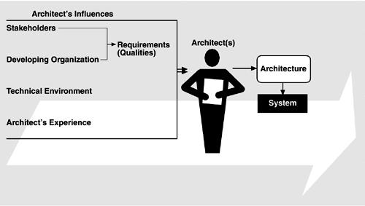
Influences on the architecture

Slide 12
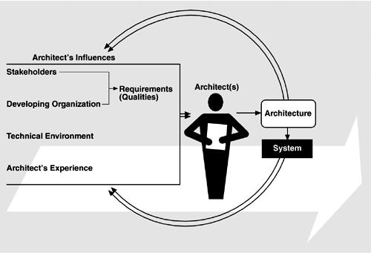
The Architecture Business Cycle

Slide 13
Ramification of influences on architecture
Know your constraints
Early engagement of stakeholders

Slide 14
Architecture Business Cycle (ABC)
Software architecture is a result of technical, business and social influences.
These are in turn affected by the software architecture itself.
This cycle of influences from the environment to the architecture and back to the environment is called the Architecture Business Cycle (ABC).

Slide 15
ABC Activities
Creating the business case for the system
  Why we need a new system, what will be its cost? Time to market, integration with existing systems?
Understanding the Requirements
  Various approaches for requirements elicitation i.e., object-oriented approach, finite-state machine models, prototyping etc.
  The desired qualities of a system shape the architectural decisions – architecture defines the trade-offs among requirements
Creating/selecting the architecture

Slide 16
ABC Activities …
Communicating the architecture
  Inform all stakeholders (i.e., developers, testers, managers, etc.)
  Architecture’s documentation should be unambiguous
Analysing or evaluating the architecture
  Evaluate candidate designs
  Architecture maps the stakeholders’ requirements/needs
Implementation based on architecture
Ensuring (result) conformance(similar) to the architecture

Slide 17
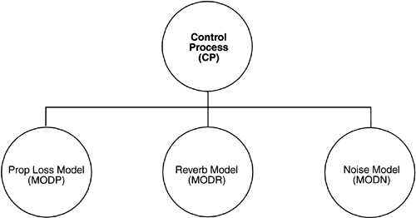
Software Architecture
Figure: Underwater Acoustic System
What is the nature of the elements?
What are the responsibilities of the elements?
What is the significance of the connections?
What is the significance of the layout?

Slide 18
Architectural Patterns
An architectural pattern is a description of element and relation types together with a set of constraints on how they may be used
these constraints define a set or family of architectures that satisfy them
They exhibit known quality attributes
client-server is a common architectural pattern
Client and server two elements
Coordination described by the protocol server uses
Multiple clients can exist

Slide 19
Reference Model
A reference model is a division of functionality together with data flow between the pieces
Reference model is a standard decomposition of a known problem into parts that cooperatively solve the problem
Show the maturity of a particular domain
  What the various parts of a compiler?
  How they interact with each other to perform a particular task?

Slide 20
Reference Architecture
A reference architecture is a reference model mapped onto software elements (that cooperatively implement the functionality defined in the reference model) and the data flows between them.
A software architect must design a system that provides
  Concurrency, portability,
  modifiability, usability, security, and
  that reflects consideration of the tradeoffs among these needs

Slide 21
Why software architecture?
Communication among stakeholders
Early design decisions
Transferable abstraction of a system

Slide 22
Other point-of-views
Software architecture is concerned with:
  Stakeholders
  System-Level Structures
  System qualities
Software architecture involves:
  Understanding domains, problems and solutions
  Making design decisions & tradeoffs
  Delivering working systems

Slide 23
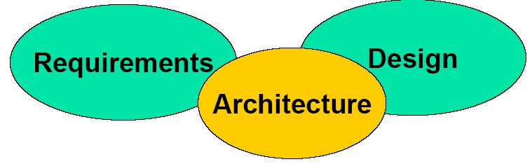
The crucial(vital, key) bridge between requirements and design

Slide 24
System-level Structures
The traditional deliverable of the software architect
Note that there are many structures
  Functional, Deployment, Information, …
Represented as a set of views
  Separate concerns
  Communicate effectively
  Organize deliverables and activities

Slide 25
Stakeholders
Those who care if the system gets built
  Can be a positive or negative interest
  Includes people, groups and entities
The reason we build systems
  Systems are built for stakeholders
  Design decisions must reflect their needs

Slide 26
System Qualities
Non-functional characteristics (“-illities”)
  Performance, Security, Availability, …
Often crucial to stakeholders
  Slow functions don’t get used
  Unavailable systems stop the business

Slide 27
Also involves:
  Functionality
  Usability
  Resilience (Flexibility)
  Performance
  Reuse
  Comprehensibility
  Economic and technology constraints and tradeoffs
  Aesthetic concerns

Slide 28
Software Architecture Views
Software architecture is commonly organized in views, which are analogous(similar) to the different types of blueprints made in building architecture.
Views are instances of viewpoints, where a viewpoint exists to describe the architecture from the perspective of a given set of stakeholders and their concerns.

Slide 29
Software Architecture Views
Logical view
Process view
Physical view
Development view

Slide 30
Logical View
This describes the architecturally significant elements of the architecture and the relationships between them.
The logical view essentially captures the structure of the application using class diagrams or equivalents.

Slide 31
Process View
This focuses on describing the concurrency and communications elements of an architecture.
In IT applications, the main concerns are describing multi-threaded or replicated components, and the synchronous or asynchronous communication mechanisms used.

Slide 32
Physical View
This depicts how the major processes and components are mapped on to the applications hardware.
It might show, for example, how the database and web servers for an application are distributed across a number of server machines.

Slide 33
Development View
This captures the internal organization of the software components, typically as they are held in a development environment or configuration management tool.
For example, the depiction of a nested package and class hierarchy for a Java application would represent the development view of an architecture.

Slide 34
How to represent Software Architecture?
Textual Representation
Graphical Representation
Architecture Description Languages (ADL)
UML as an ADL???

Slide 35
Architectural Description Languages
ADL is a set of notations, languages, standards and conventions for an architectural model.
A language that is designed specifically for the representation and analysis of software architectures.
It defines a formal syntax for expressing architectures and assigns a semantic interpretation.

Slide 36
ADLs
Several different ADLs have been developed by different organizations, including:
  AADL (Society of Automotive Engineers standard)
  Wright (developed by Carnegie Mellon)
  Acme (developed by Carnegie Mellon)
  xADL (developed by UCI)
  Darwin (developed by Imperial College London

Slide 37
ADL vs. Standard Design Notations
ADLs differ from standard system design notations in the following manner:
  ADLs tend to support components of larger granularity and are more often tailor-able to a specific domain.
  ADLs (ideally) provide constructs to support reuse, rapid prototyping, connections as first class entities, and rationale for constraints imposed on architectural components and connections

Slide 38
ADL vs. Standard Design Notations
ADLs provide for a larger and more encompassing view of the software than standard design notations while at the same time providing, through various architectural views, enough detail for analysis and evaluation.

Slide 39
UML as ADL
Several languages for describing software architectures have been devised(created), but no consensus(agreement) has yet been reached on which symbol-set and view-system should be adopted.
The UML was established as a standard "to model systems (and not just software)," and thus applies to views about software architecture.

Slide 40
References and further reading
Chapter 1 of “Software Architecture and Practice” by Len Bass

